Slide 1
Python for kids
CSE499B: Senior Project
Team Members
Name | ID
Mahmud Ahmed | 1431000642
Md. Tamim Hasan | 1521032042
Lamia Rahman | 1711048642

Slide 2
Problem Analysis
Making a platform for the Kids aged 7+ to learn Python programming
Python is an Intermediate level programming language
Making usability fun and interesting for the kids to learn
Trying to create a colorful and interesting UX design of the app

Slide 3
Related Works
Market competitors targeted teaching Scratch Programming for the young children
Code.org, Khan Academy Kids, others also trying to make suited platform.
Making learning interesting to the children, so that they can learn better.

Slide 4
What did you do over the course
Software development methodology
Agile development method
Communication between the members
Use of the digital communication using the platform of the e-mail, messenger, slack
Divided the work in parts
Research and analysis →Mahmud Ahmed
Front-end → Lamia Rahman
Backend and database connection → Tamim Ahmed

Slide 5
What part of the project is most unique/original?
Not many websites teaches Python as a language for the beginners i.e. For kids
Teamwork helped to gather information faster.
Different opinions from different members
Implementing games and quizzes section for kids to learn

Slide 6
What tools did you use?
GitHub
~ To push the code of the project along with other different documentation.
Laravel
~ Using the Laravel PHP framework to implement the web app project
~ Using the Laravel as a backend with MySQL and MongoDB ORM
React
~ Using the React framework for frontend
~ Used some TailwindCSS framework components

Slide 7
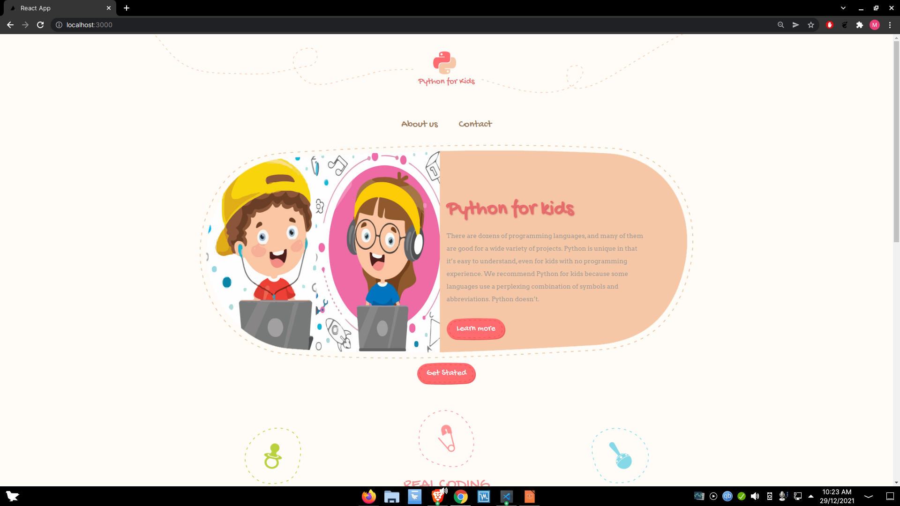
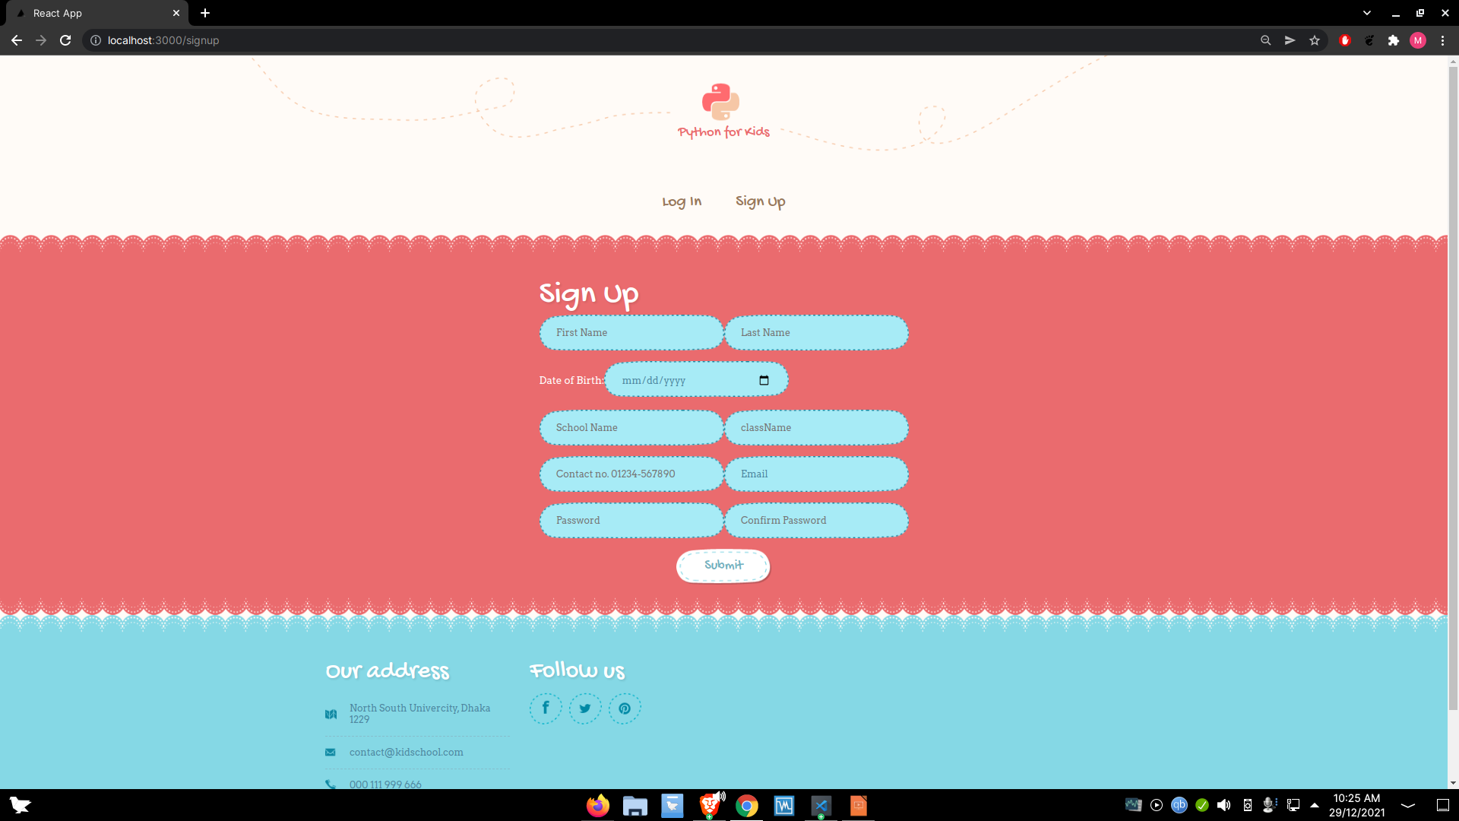
Design of the project
Easy home screen menu interface
Colorful Flash Screen of the app

Slide 8
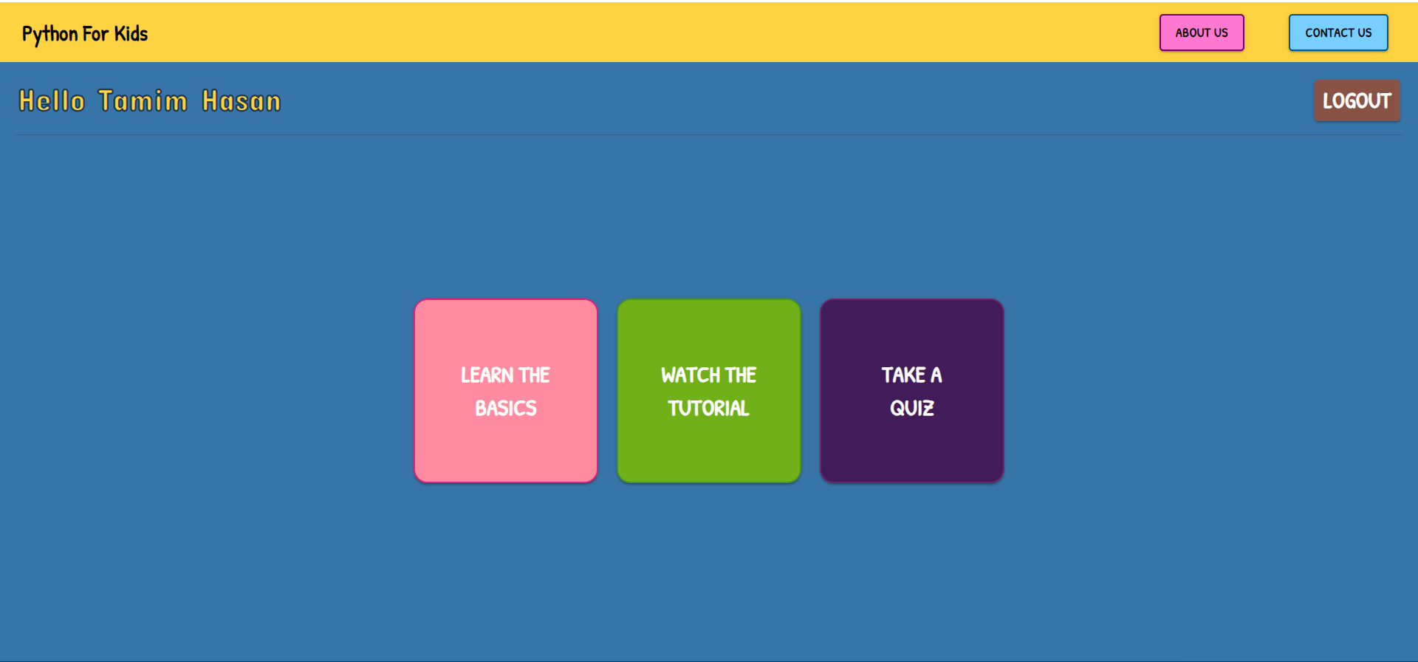
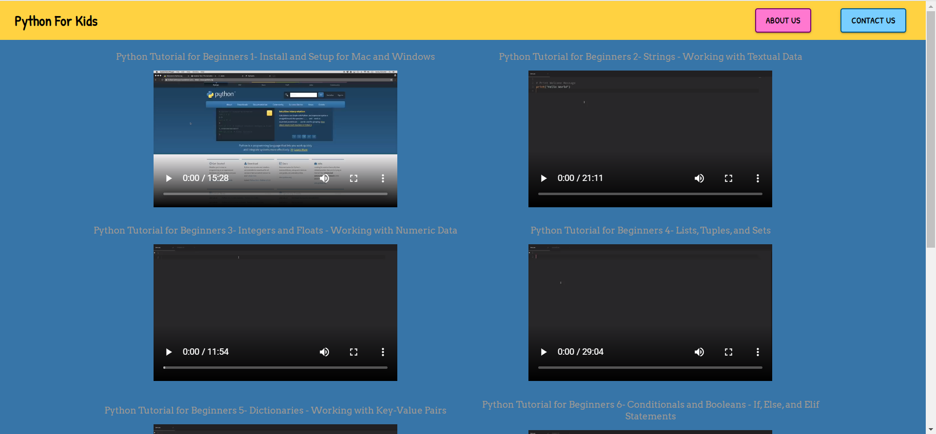
Design of the project

Slide 9
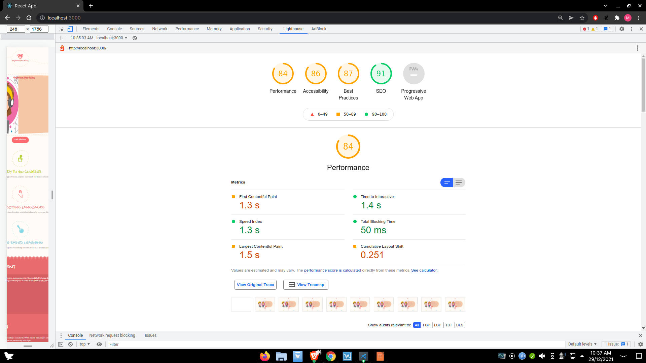
Result Analysis
We did the Lighthouse report from chrome analytics tools. That giving 84% performance
We will be changing anything that is needed to increase the performance and the page

Slide 10
Thank you

